Slide 1

Unit 11 : Computer Networks First Music Computer Network
A: Understand the features and uses of computer networking
B: Design a computer network
C: Develop and test a computer network
D: Review the finished computer network

Slide 2
The uses and features of two different computer networks:
Investigate two different kinds of computer network to discuss Strengths and weaknesses of both.

Slide 3
Difference between wired and wireless connections :
Wired connection
+A wired network employs wires to link devices to the Internet or another network, such as laptops or desktop PCs.
- Example: In the networking world, “Wired” as the name suggests refers to any physical medium connected through wires and cables. The wires/cables can be copper wire, twisted pair or even fibre optic. Wired connectivity is responsible for providing high security with high Bandwidth provisioned for each user.
- In fact, Wired connectivity is considered highly reliable and incurs very low delay, unlike Wireless connectivity.
Wireless connection
+Wireless Network Connections: “Wireless” means without wire, media that is made up of electromagnetic waves (EM Waves) or infrared waves. Antennas or sensors will be present on all wireless devices.
- Example: Cellular phones, wireless sensors, TV remotes, satellite disc receivers, and laptops with WLAN cards are all examples of wireless devices. For data or voice communication, a wireless network uses radiofrequency waves rather than wires.
- Though wireless connectivity is less secured and higher delay than wired connectivity, it is still preferred communication technology for customers. Wireless also earns low Installation cost in contrast to wired connectivity.

Slide 4

Investigate two different kinds of computer network to discuss Strengths and weaknesses of both.
Increasingly, the needs of modern homes and workspaces are for greater and more versatile internet coverage than just having a single PC, or group of PCs wired up to a router with ethernet cables.
Wireless networks enable multiple devices to use the same internet connection remotely, as well as share files and other resources.
LAN is the ‘Local Area Network.’ As the name suggests, it works to connect local computers.
WLAN is ‘Wireless Local Area Network.’ Wireless means connection without physical wire.
Next page

Slide 5

LAN Advantage:
Simple and relatively inexpensive: The primary benefit of a local area network is that this is quick and easy to set up and reasonably priced when contrasted to other alternatives; consequently, if an organization intends to build a network at a minimal price and with flexibility, a local area network is the ultimate answer.
Fast communication: LAN-connected systems or devices communicate directly at very high rates of speed, based on the LAN model and ethernet cabling installed. The most prevalent enabled speeds are 10 Mbps, 100 Mbps, and 1000 Mbps. Technologies of gigabit ethernet are quickly developing. Once the technology becomes more sophisticated and large-scale production has commenced, lower-cost variants will be accessible to the public.

Slide 6

LAN Disadvantage:
All devices may be disproportionately affected if the server fails: If a file on the server gets heavily damaged or a hard disc crashes, all the linked PCs will have extreme difficulty operating correctly.
Long-distance major limitation: Local area networks are often devised within a building or apartment complex and cannot be stretched to a bigger area.

Slide 7
WLAN Advantage:
Wireless networks can sometimes handle a larger number of users because they are not limited by a specific number of connection ports.
As WLAN reduces physical wires so it is a flexible way of communication.
It provides high data rate due to small area coverage.
The direction of connectivity can be anywhere i.e. you can connect devices in any direction unless it is in the range of access point

Slide 8

WLAN Disadvantage:
File-sharing transfer speeds are normally slower with wireless networks than they are with cabled. The speeds can also vary considerably according to your location in relation to the network.
WLAN uses frequency which may interfere with other devices which use frequency.
Signals could also be suffering from the environment as compared to using fiber optics.

Slide 9

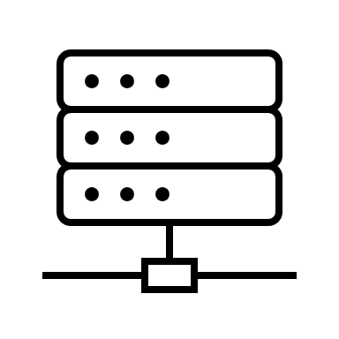










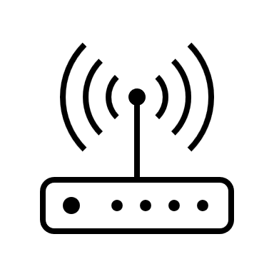


CCTV
Switch HUB
CCTV
SERVER 1
Internet
Firewall
Printer
SERVER 2
Honey pods
Router
SERVER 3
(backups)
WIFI Router
CCTV
CCTV

Slide 10

1. Network Design:
Local Area Network (LAN):
- Implement a wired LAN infrastructure to ensure stable and high-speed connectivity throughout the store.
Network Security:
- Deploy a firewall, antivirus software, and encryption protocols to protect the network from unauthorized access and ensure data security.
Wireless Access Points (WAPs):
- Install WAPs strategically within the store to provide wireless internet access for customers and staff.

Slide 11
2. Hardware Requirements:
- Three high-spec computers:
- Sales and Stock Control: computer dedicated to sales and stock control operations.
- Classes and MP3 Devices: computer to be used for classes on downloading music and configuring MP3 devices.
- Manager's Office: computer set up in the manager's office for administrative tasks.
- Network Switch: Install a network switch to connect the computers, printers, and other network devices.
- Printer: Set up a centralized printer that can be accessed by all computers on the network.
- Scanner: Include a network-connected scanner for document digitization and archiving.
- External Storage Device: Attach an external storage device for shared file storage and backup purposes.

Slide 12
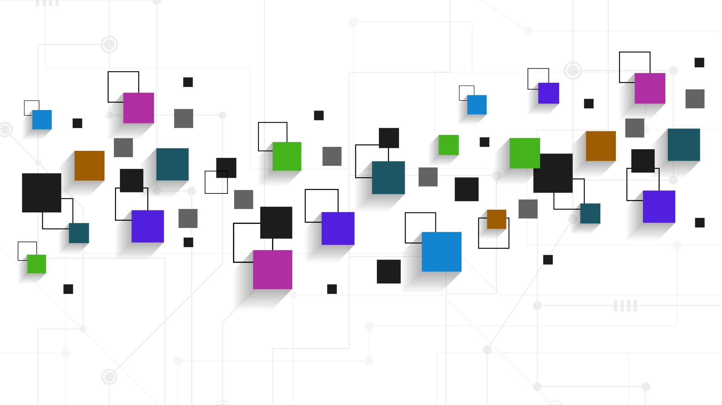
3. Software and Applications:
Operating System:
- Choose a suitable operating system like Windows or macOS for the computers based on compatibility and user preferences.
Application Software:
- Sales and Stock Control: Utilize specialized inventory management and point-of-sale (POS) software to streamline sales operations and track inventory.
Classes and MP3 Devices:
- Install software applications that facilitate downloading music and configuring MP3 devices, ensuring a user-friendly experience.
Administrative Tasks:
- Install office productivity software, such as word processing and spreadsheet applications, to meet the manager's administrative needs.

Slide 13
4. User Management and Access Control:
User Accounts:
- Set up individual user accounts for network users, including the administrator with full control over the network.
Access Permissions:
- Configure different access permissions for shared folders and files to control user access based on their roles and responsibilities.
Password Management:
-Implement password policies and enable password change/reset mechanisms to enhance security.
User Account Administration:
- Provide the ability to add, remove, and modify user accounts, change passwords, and manage login restrictions.

Slide 14
5. Network Utilities and Security Measures:
Remote Desktop:
Enable remote desktop functionality to facilitate remote access and troubleshooting of computers.
Instant Messaging:
Install an instant messaging application to enhance communication and collaboration among staff members.
Antivirus and Firewall:
Deploy robust antivirus software and a firewall to protect the network from malware, viruses, and unauthorized access attempts.

Slide 15

6. Future Expansion and Scalability:
Website Development:
Plan development of a general information website and a secure e-commerce website to facilitate online sales.
Network Capacity:
Design the network infrastructure with scalability in mind, allowing for additional devices, increased network traffic, and future growth.
Cloud Integration:
- Explore cloud-based solutions for storage, backup, and hosting the websites to minimize hardware and maintenance costs.

Slide 16
7. Cost Considerations:
Hardware Components:
- Research and select cost-effective hardware components that meet the required specifications and future expansion plans.
Software Resources:
-Evaluate different software options, considering both the upfront costs and long-term licensing fees, to optimize the software budget.
By incorporating these elements into your network design, you can ensure that 'First Music' has a secure, efficient, and scalable network and computing system that fulfils the immediate requirements and accommodates future growth.

Slide 17
Network Diagram: a visual representation of this network structure, including 9 Pc devices , connections is LAN and WLAN, and IP addresses (if applicable). Picture is showing the positioning of network devices and equipment within the store.
The purpose of the new computer network for 'First Music' is to establish a robust and secure network infrastructure that supports the following user requirements:

Slide 18
1-Customers: -Access the network for music downloads and online browsing. -Seamless and reliable connectivity. -Connect MP3 devices to the customer computers for data transfer. -Individual login credentials for each customer for personalized access. 2-Sales and Stock Control Operations: -Dedicated computer for managing sales and stock control processes. -Fast and efficient connectivity to ensure real-time updates. 3-General Office Computer: -Connectivity to the network for administrative tasks and access to shared resources. -Wireless connectivity for flexibility and convenience.
The purpose of the new computer network for 'First Music' is to establish a robust and secure network infrastructure that supports the following user requirements:

Slide 19
4-Servers and Data Protection: -General Server: Centralized storage and management of data. -Honey Pods: Additional security layer for protecting the server against potential hackers. - Backup Server : Stores duplicate copies of data for disaster recovery. - Firewall, antivirus software, and encryption protocols for network security. 5-Printer: - Connected to the switch hub for accessibility by all customers. 6-CCTV Security: - Network integration of CCTV cameras for surveillance and security purposes.

Slide 20
The network structure for 'First Music' is as follows: 1-Networking Components: -LAN: Connects the 8 customer computers and the sales and stock control computer. -Firewall: Controls and filters incoming and outgoing internet traffic. -Router: Provides internet connectivity and routes data packets. -Switch Hub: Connects various network devices, servers, customer computers, and printer. -Wi-Fi Router: Provides wireless connectivity for devices, including the general office computer. 2-Servers: -General Server: Centralized storage and management of data. -Honey Pods: Additional security layer for protecting the server against potential hackers. -Backup Server: Stores duplicate copies of data for disaster recovery purposes.
Description of Network Structure:

Slide 21
3-Printer: Connected to the switch hub for accessibility by all customers. 4-CCTV Security: Integrated into the network infrastructure for surveillance and security monitoring.

Slide 22
1-Network Diagram: -Illustrates the structure of the network, including LAN connections, networking components, servers, printer, Wi-Fi connectivity, and CCTV security integration. -Includes the positioning of the devices and their connections. 2-Security Measures: -Deploy a firewall, antivirus software, and encryption protocols to protect the network from unauthorized access and ensure data security. 3-Customer Computers: -Each customer computer will have software installed to facilitate music downloads and MP3 device connectivity. -Each customer will have their own unique username and password for personalized access.
Detailed Design Documentation:

Slide 23
1-Fulfilling Purpose and User Requirements: -The network design enables customers to download music, connect MP3 devices, and access personalized accounts. -Sales and stock control operations have dedicated computer connectivity for efficient management. -The general office computer is wirelessly connected for flexibility. -Servers and security measures ensure centralized data management, protection, and disaster recovery. -The printer is accessible to all customers, enhancing convenience. 2-Impact of Constraints: -Hardware and Software Availability: Selected reliable and cost-effective networking components, servers, and security software within budgetary constraints. -Security Measures: Implemented necessary security measures to protect against unauthorized access and ensure data privacy. -Alternative Designs: Evaluated alternative hardware and software options based on cost, scalability, and compatibility. Rejected alternatives that were overly expensive, lacked necessary features, or were incompatible with existing systems.
Justification and Impact of Constraints:

Slide 24
By considering the user requirements, the implementing necessary security measures, and addressing the impact of constraints, the proposed computer network will update, and we will work on weaknesses.
* the proposed computer network design for 'First Music' aims to provide a secure, efficient, and capable solution to meet their needs.

Slide 25
LAN Action Plan
Item | Type | Reaction | Date | Security
Connectivity | LAN | Connected without error | 07/03/2023 | ManageEngine Firewall Analyzer Software
Reliability | UDP | Reliable | 07/03/2023 | ManageEngine Firewall Analyzer Software
Download Speed | Mbps | 635.9 | 07/03/2023 | ManageEngine Firewall Analyzer Software
Upload Speed | Mbps | 177.0 | 07/03/2023 | ManageEngine Firewall Analyzer Software
Frequency | Core: 5.0 GHz band | Satisfying | 07/03/2023 | techsession.be
Performance | Gamer User | Excellent result | 07/03/2023 | User and password

Slide 26
WLAN Action Plan
Item | Type | Reaction | Date | Security
Connectivity | WLAN | Connected But A few Jamming | 07/03/2023 | ManageEngine Firewall Analyzer Software
Reliability | TCP | Reliable | 07/023/2023 | ManageEngine Firewall Analyzer Software
Download Speed | Mbps | 109.9 | 07/03/2023 | ManageEngine Firewall Analyzer Software
Upload Speed | Mbps | 99.0 | 07/03/2023 | ManageEngine Firewall Analyzer Software
Frequency | Core: 2.4 GHz band | Sufficient | 07/03/2023 | techsession.be
Performance | Gamer User | Convincing | 07/03/2023 | User and password

Slide 27
SOURCE:
test speed - Google Search
Wireless LAN & WAN - Tech Session
User Datagram Protocol - Wikipedia
What do you mean by reliability of computer network? How it is provided? - Quora
https://www.computer-solutions.co.uk/chipdev/tcpwnw.html
https://www.computer-solutions.co.uk/chipdev/tcpwnw.html
https://www.pcwdld.com/access-management#wbounce-modal
https://ipwithease.com/wired-network-vs-wireless-network/
https://digitalworld839.com/types-of-networks-computer/

